Slide 1

Building Modern Mobile Apps
Cordova
Kevin Ford
Mobile Practice Lead
Magenic
Level: Intermediate

Slide 2
Kevin Ford
KevinF@magenic.com
@Bowman74
http://windingroadway.blogspot.com
https://github.com/Bowman74

Slide 3
Mobile Tasks Source Code
GitHub
https://github.com/brentedwards/MobileTasks

Slide 4
What is Cordova Development?

Slide 5
Cordova History
Originally Nitobi
Purchased by Adobe in 2011
Cordova Open Source (Apache 2.0 License)
PhoneGap Product Version of Cordova

Slide 6
IDEs

Slide 7
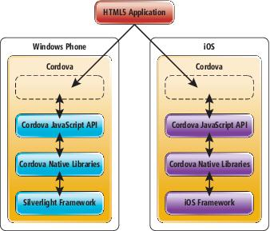
How does Cordova Work?

Slide 8


Supported Platforms?
Notes:
Android 2.3.3 and later (4.4 provides the best developer experience)
iOS 6, 7, and 8
Windows 8 and 8.1
Windows Phone 8 and 8.
Windows Universal

Slide 9





What do I need?
Notes:
This stuff is installed for you.

Slide 10
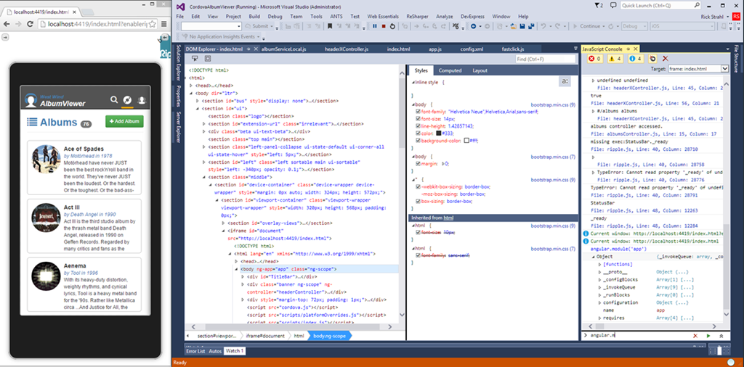
Emulator Options - Ripple

Slide 11
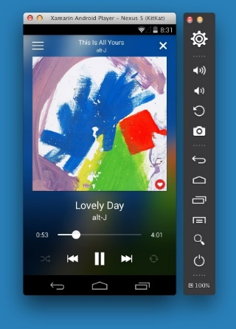
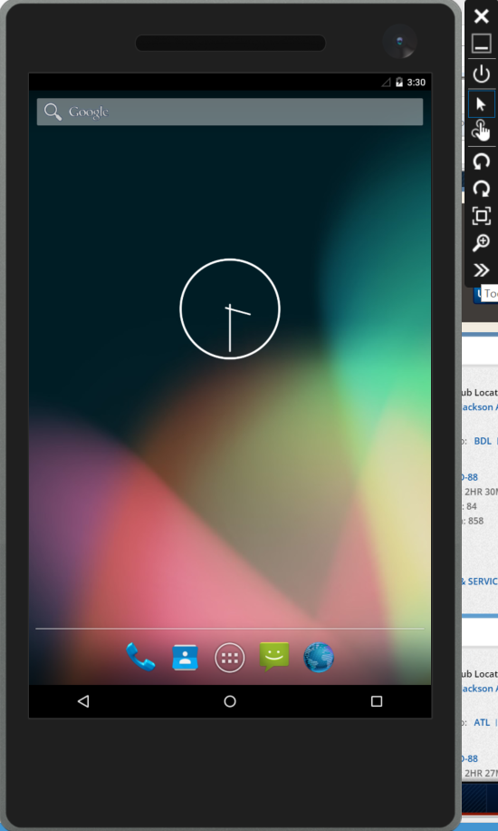
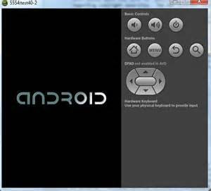
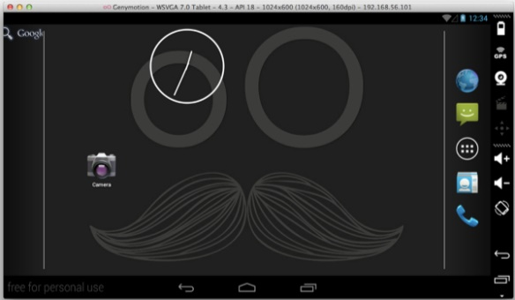
Emulator Options - Android

Slide 12
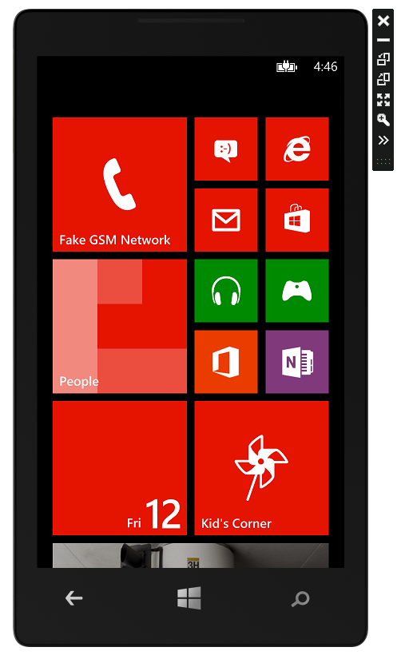
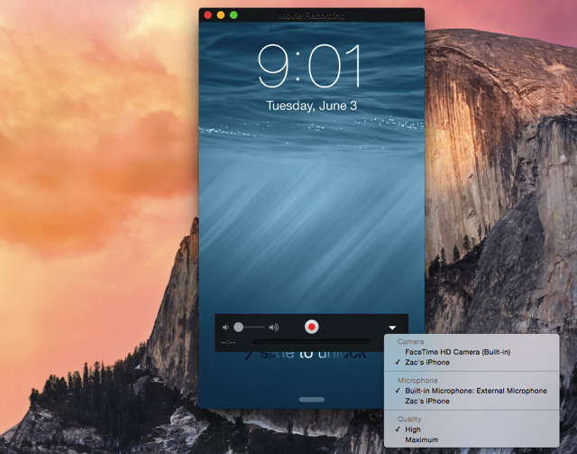
iOS and Windows Phone

Slide 13
Plugins
Listed in config.xml
Cross Platform API Access in JavaScript
Written in Native Languages (Objective-C, Java, C#)
Plugin Directory - http://cordova.apache.org/plugins/
Abstraction APIs Can Hide Native Features
Changes May Lag Latest Platform Changes

Slide 14








What about the UI?

Slide 15
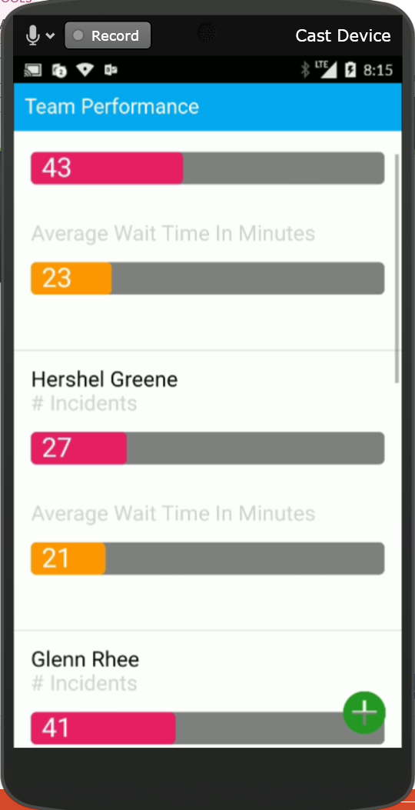
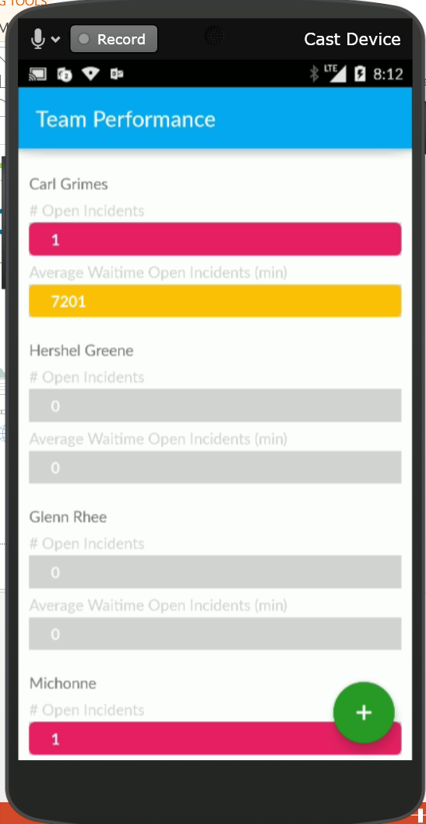
A Tale of Two Apps

Slide 16
Adding an UI Framework

Slide 17
About Ionic
Uses Angular
Styles UI
Extra Utilities
Ionic Lab
Live Reload
App Viewer

Slide 18
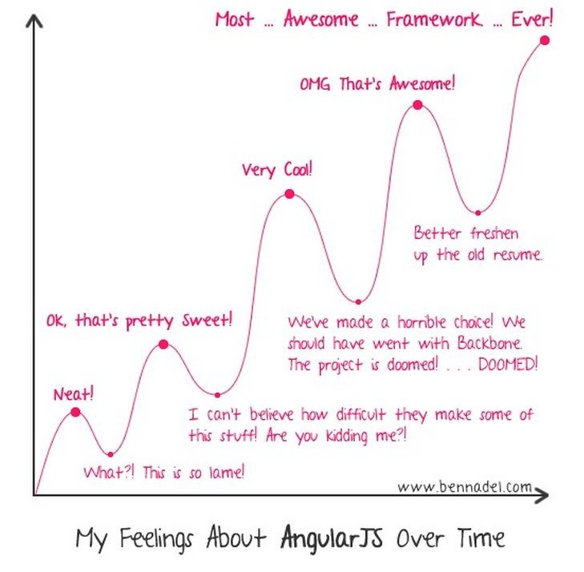
Angular Learning Curve

Slide 19
Angular – Single Page Application
Main Page
View 1
<html>
<script src="/Scripts/angular.min.js"></script>
<div data-ng-app=“Module”>
View 2
View 1
View 2
View 3
View 1
View 4
View 3
View 4
</div>
</html>

Slide 20
Setting up Ionic
npm install –g cordova ionic
Ionic start <app name> <app type>
App Types: blank, tabs, sidemenu, slide
To work in Visual Studio with TACO
https://taco.visualstudio.com/en-us/docs/interoperability/

Slide 21
Creating a Page
Basic Structure
Pages
<ion-content>
</ ion-content >
List
<div class=“pages">
</div>

Slide 22
Binding
@Scope implied
Will add member to $scope dynamically if needed
Display: <td>{{ registration.ScreenName }}</td>
Edit: <input data-ng-style="width: 50%" type="text" id="txtBirthDate" data-ng-model="Model.BirthDate" />

Slide 23
Validation/Formatting Syntax
Formatting
<td>{{ Name | uppercase }}</td>
<td>{{ OtherName | lowercase }}</td>
<td>{{ SomeDate | date:'MM-dd-yyyy' }}</td>
Validation
<input type="text" id="txtName" data-ng-model=“MyText" required />
<input type="text" id="txtName" data-ng-model="MyText" required="" data-ng-required=“IsNameRequired()" />
<input type="text" id="txtZip" data-ng-model=“MyZip" data-ng-required=“IsZipRequired()" data-ng-pattern="PostalCodeMask" />
Errors
<span data-ng-show="myForm.txtZip.$error.required">required</span>
<span data-ng-show="myForm.txtZip.$error.pattern">Postal Code Format is not valid</span>

Slide 24
Connecting to Azure
Installed via Plugin
Asnyc done via callback (.done {} )
Table Result Format: result[record index][field name]
Json handling via GSon

Slide 25
Conclusion
Fastest way to Create X-Platform Apps
UI Compromises
Plugin Limitations
Can use Node.js for Unified Stack
Performance Comprimises

Slide 26
Questions?

